Slide 1

Employee Management System
Innomatics Research Labs
Dilsukhnagar
Batch No : 484
Team:
M. Murali Krishna

Slide 2
About me
I am Murali Krishna.
I completed my B.Tech in Computer Science and Engineering (AI & DS) from Sri Indu College Of Engineering and Technology.
I am pursuing a course in Data Analytics to gain practical knowledge in exploring, analyzing and interpreting data for meaningful problem-solving.
LinkedIn: https://www.linkedin.com/in/muralikrishna-1zb2
Git Hub : https://github.com/mellurimurali
Mail : mellurimurali@gmail.com

Slide 3
Agenda
Business Problem
Problem Statement
Introduction
Table Structure
ER Diagrams
Queries
Insights
Challenges

Slide 4
Business Problem
Many organizations struggle to manage employee information efficiently due to :
Data redundancy and inconsistency
Payroll calculation errors
Challenges in maintaining secure and accurate employee records
Delays in HR reporting and decision-making
The company requires a centralized Employee Management System (EMS) that can:
Store and manage employee information efficiently
Track departments, job roles, and salary structures
Ensure data integrity using relational database concepts
Maintain qualification and leave records

Slide 5
PROBLEM STATEMENT
Manual/fragmented employee data management → errors & inefficiency
Difficulty in retrieving/updating employee records quickly
Payroll processing errors due to manual calculations
Lack of transparency in leave and job role management
No centralized system for tracking qualifications, salaries, and departmental roles
Data inconsistency without relational integrity (PKs, FKs, cascading updates)
Need for a robust Employee Management System (EMS) to:
Store & manage employee details securely
Automate payroll & leave tracking
Ensure data accuracy and consistency
Provide insights through queries & reports
Streamline HR operations and decision-making

Slide 6
Project Objectives
Develop a centralized Employee Management System using SQL
Manage employee, department, payroll, qualification, and leave data efficiently
Ensure data accuracy and consistency using relational database concepts
Ensure data consistency and integrity using constraints and cascading actions
Perform analytical queries to generate business insights related to employees, payroll, departments, and leaves

Slide 7
PROJECT INTRODUCTION
The Employee Management System (EMS) is designed to streamline the management of employee data, job roles, and departmental information within an organization. This system allows for efficient tracking of employee details
The system provides a centralized platform to store, retrieve, and update employee details such as employee information , job roles, departmental assignments, payroll, qualifications, and leave records.

Slide 8
TABLE STRUCTURE
There are six tables in the database as follows:
Job Department
Salary/Bonus
Employee
Qualification
Leaves
Payroll

Slide 9
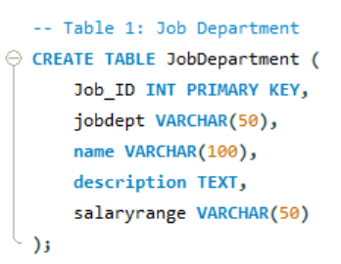
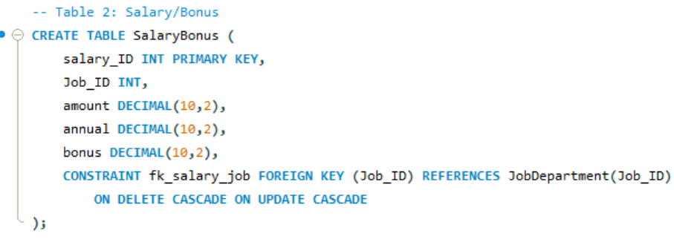
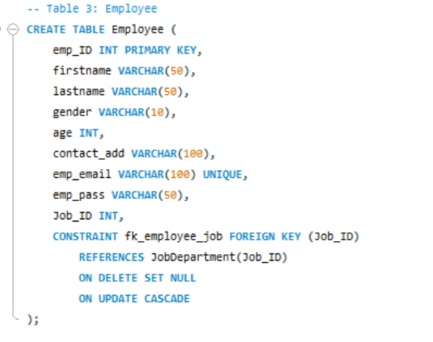

Slide 10
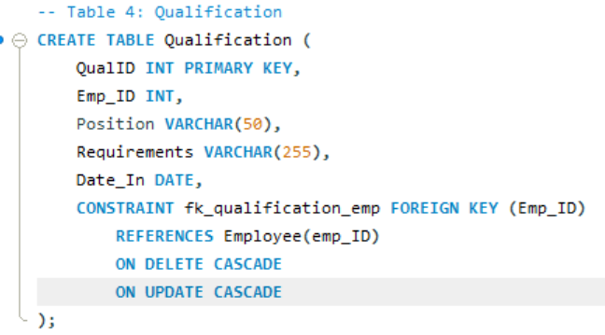
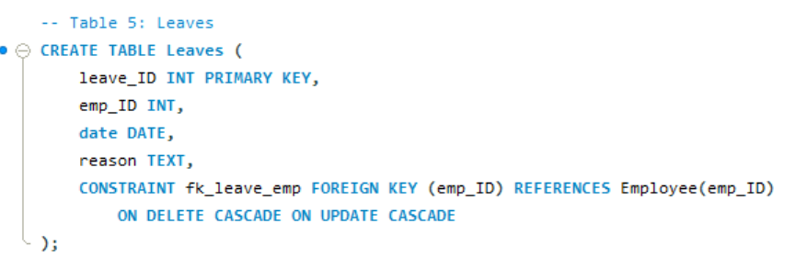

Slide 11
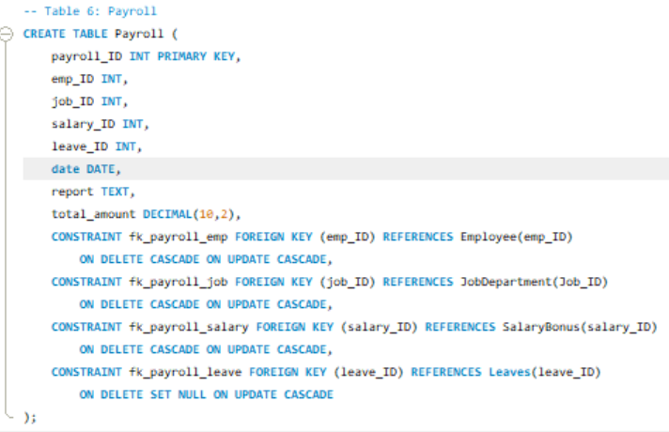

Slide 12
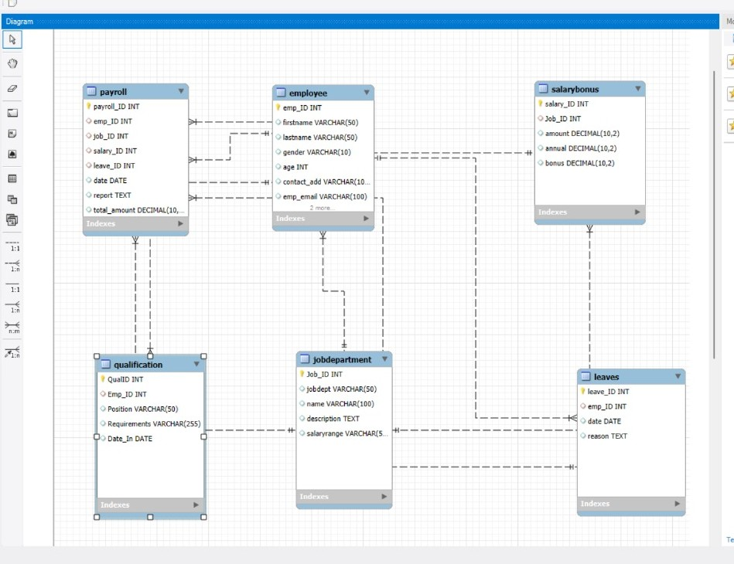
ENTITY RELATIONSHIP (ER) DIAGRAM

Slide 13
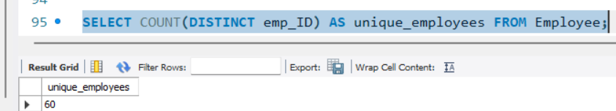
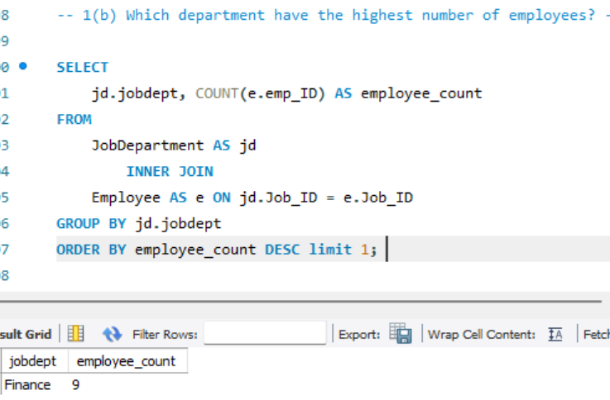
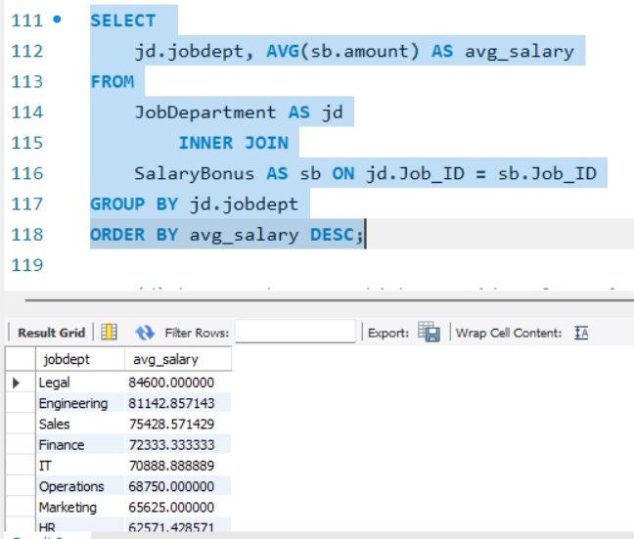
QUERIES:
1. EMPLOYEE INSIGHTS
1(b) Which department have the highest number of employees?
1(a)How many unique employees are currently in the system?
1(c)What is the average salary per department?

Slide 14
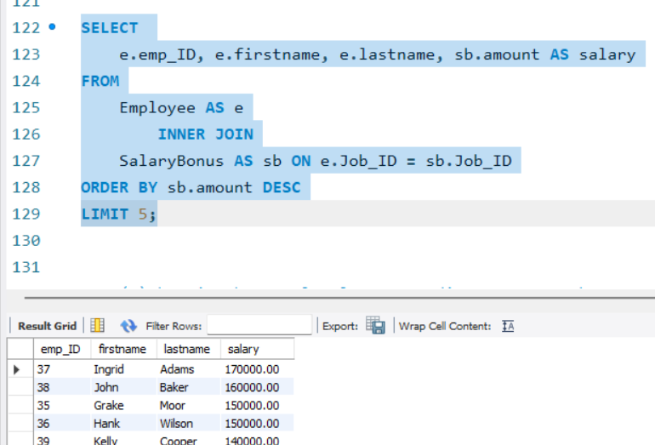
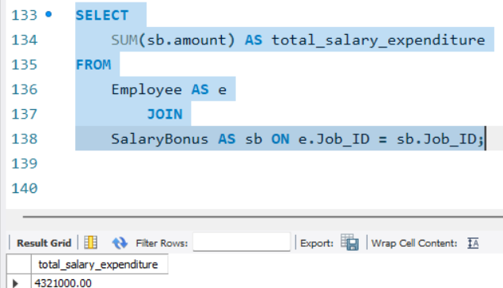
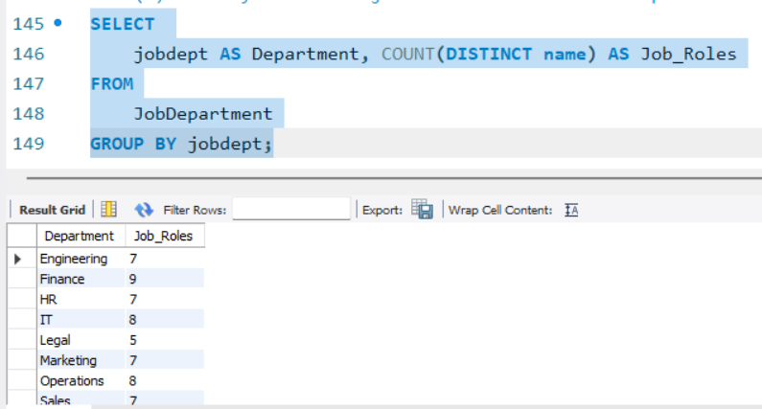
1(d)Who are the top 5 highest-paid employees?
1(e)What is the total salary expenditure across the company?
2. JOB ROLE AND DEPARTMENT ANALYSIS
2(a)How many different job roles exist in each department?

Slide 15
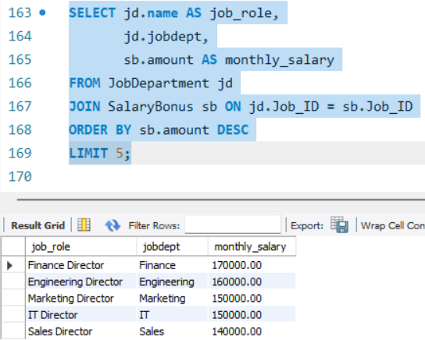
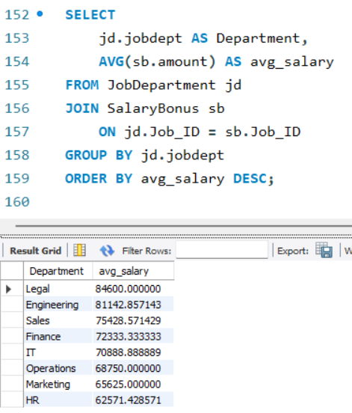
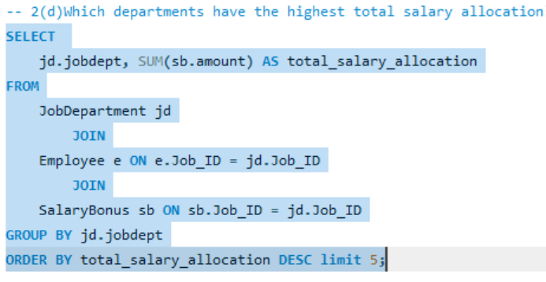
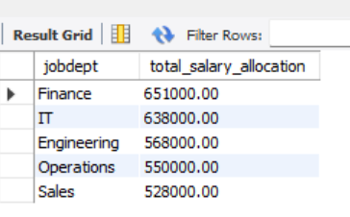
2(b)What is the average salary range per department?
2(c)Which job roles offer the highest salary?
2(d)Which departments have the highest total salary allocation?

Slide 16
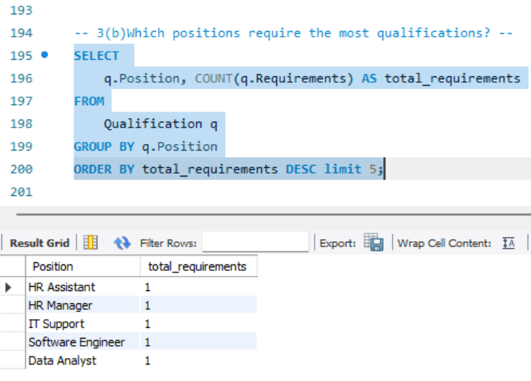
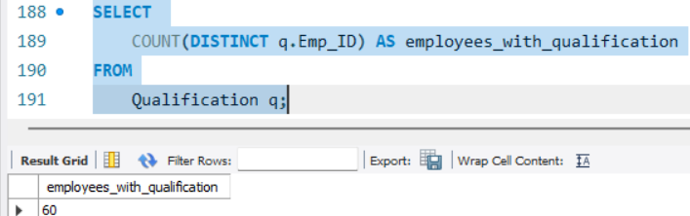
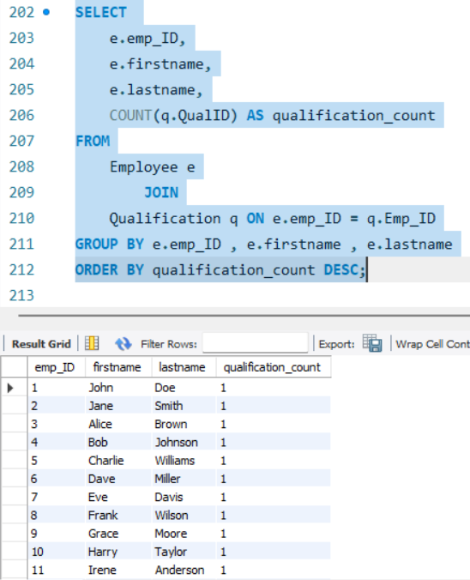
3. QUALIFICATION AND SKILLS ANALYSIS
3(b)Which positions require the most qualifications?
3(a)How many employees have at least one qualification listed?
3(c)Which employees have the highest number of qualifications?

Slide 17
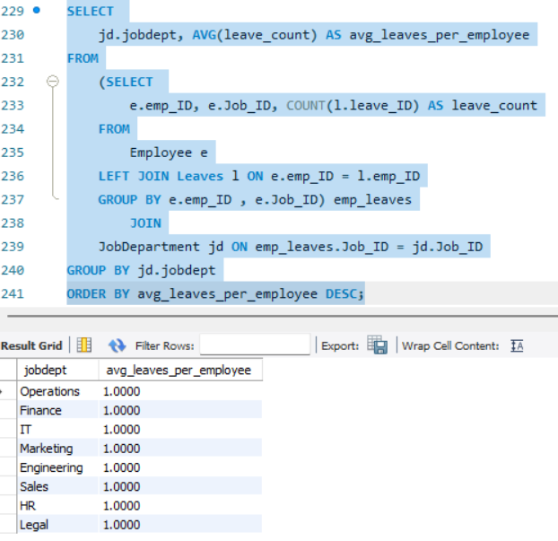
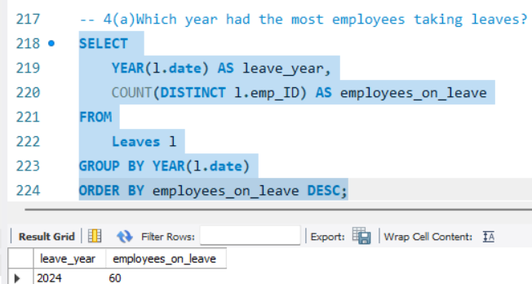
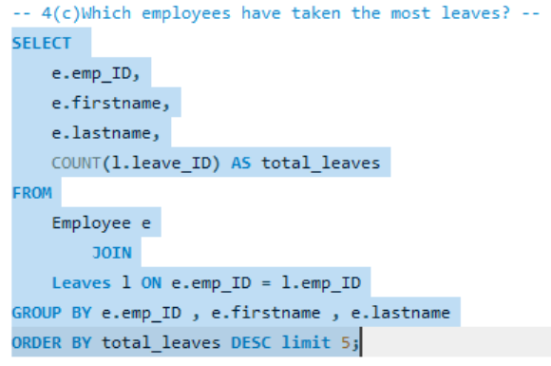
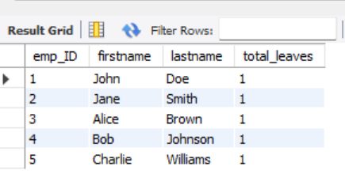
4. LEAVE AND ABSENCE PATTERNS
4(b)What is the average number of leave days taken by its employees per department?
4(a)Which year had the most employees taking leaves?
4(c)Which employees have taken the most leaves?

Slide 18
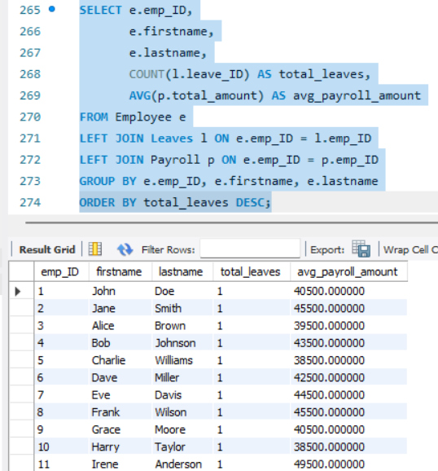
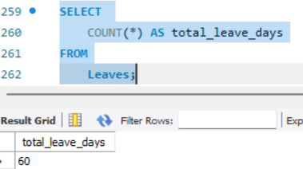
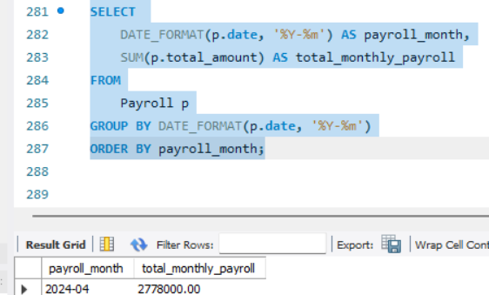
4(d)What is the total number of leave days taken company-wide?
4(e)How do leave days correlate with payroll amounts?
5.PAYROLL AND COMPENSATION ANALYSIS
5(a)What is the total monthly payroll processed?

Slide 19
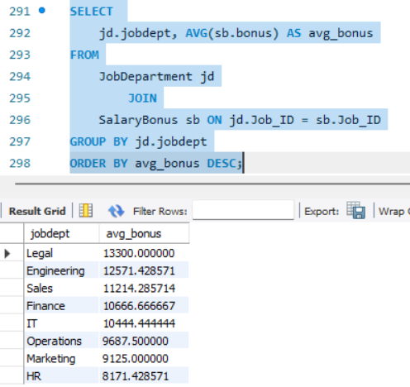
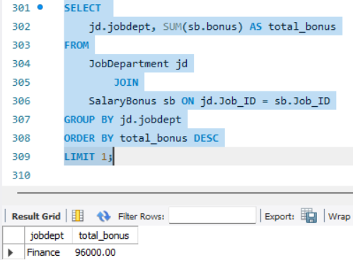
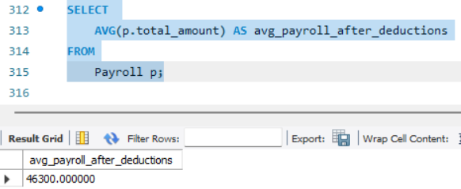
5(b) What is the average bonus given per department?
5(c) Which department receives the highest total bonuses?
5(d) What is the average value of total amount after considering leave deductions?

Slide 20
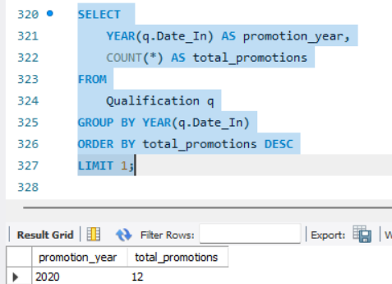
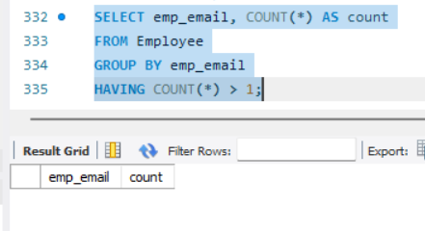
6. EMPLOYEE PERFORMANCE AND GROWTH
6(a)Which year had the highest number of employee promotions?
To check duplicates in the data

Slide 21
INSIGHTS:
Identifies which departments have the highest number of employees
Average salary per department and total salary expenditure reveal how budgets are allocated across roles.
Analysis shows which year had the most employees taking leaves and how leave days correlate with payroll amounts.
The system tracks promotions by year and shows which employees/positions have the highest number of qualifications

Slide 22
CHALLENGES:
Maintain relationship between tables with proper use of foreign keys so that we can perform operations
Write proper Sql joins for generating reports across employees, roles, leaves, and payroll.
Check any duplicates in the data

Slide 23

THANK YOU

